Slide 1
WAN Technologies and Routing

Slide 2
Introduction
LANs cannot be extended arbitrarily far or handle arbitrarily many computers
Distance limitations even with extensions
Broadcast a problem
Need other technologies for larger networks

Slide 3
Characterizations of networks
Personal Area Network (PAN) – spans a region near an individual
Local Area Network (LAN) - single building or a campus
Metropolitan Area Network (MAN) - intra city
Wide Area network (WAN) – inter-city, country, continent, planet

Slide 4
Large Spans and Wide Area Networks
The key issue that separates WAN technologies from LAN technologies is scalability
A WAN must be able to grow as needed to connect many sites
spread across large geographic distances
A technology is not classified as a WAN unless it can deliver reasonable performance for a large scale network
A WAN does not merely connect to many computers at many sites
it must provide sufficient capacity to permit all computers to communicate
a satellite bridge that connects a pair of PCs and printers is merely an extended LAN

Slide 5
Packet switches
To span long distances or many computers, network must replace shared medium with packet switches
Each switch moves an entire packet from one connection to another
A small computer with network interfaces, memory and program dedicated to packet switching function
Early packet switches were constructed from conventional computers

Slide 6
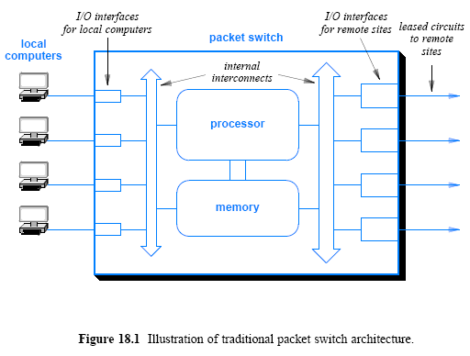

Slide 7
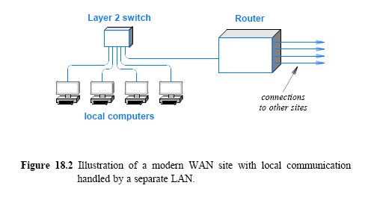
Traditional WAN architecture
A packet SW showing two parts:
A layer 2 SW that connects local computers
A router that connects to other sites

Slide 8
Forming a WAN
The details of the interconnections depend on
the data rate needed
the distance spanned
and the delay
Many WANs use leased data circuits
Other forms also exist
Microwave, satellite channels
A network designer must choose a topology
For a given set of sites, many topologies are possible

Slide 9
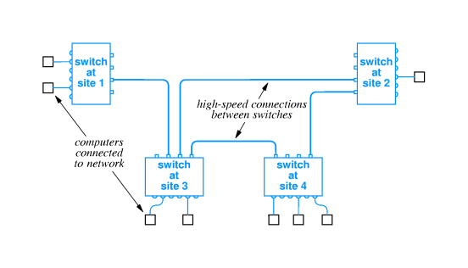
Connections to packet switches
Packet switches may connect to computers and to other packet switches
Typically high speed connections to other packets switches, lower speed to computers
Technology details depend on desired speed (T3 circuit, OC-12, etc)
Packet switches can be linked together to form WANs (scalability)

Slide 10
Layer 2 Switch Structure
Control Unit
Switching table
buffer
1
2
3
4
5
6
7
Frame out
Frame in
Local computers

Slide 11
Store-and-forward switch
Stores incoming packets in the input buffer and forwards the packets to another switch or computer
I/O hardware places a copy of packet in memory
When forwarding, the processor
Examines the packet
Determines its destination
Sends it to appropriate I/O interface

Slide 12
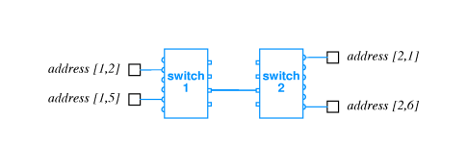
Physical addressing in a WAN
Similar to LAN
Data transmitted in packets (equivalent to frames)
Each packet has format with header
Packet header includes destination and source addresses
Many WANs use hierarchical addressing for efficiency
One part of address identifies destination switch
Other part of address identifies port on switch
In practice, an address is represented as a single binary value with some bits of the binary value
used to represent a packet switch
and others used to identify a computer

Slide 13
Next-hop forwarding
Outgoing connection for forwarding
Direct packet delivery for a local computer
To another switch, forwards packets only to next hop
Choice based on destination address in packet
each packet switch contains a forwarding table or routing table
All possible packet switches
A next hop info for each switch

Slide 14
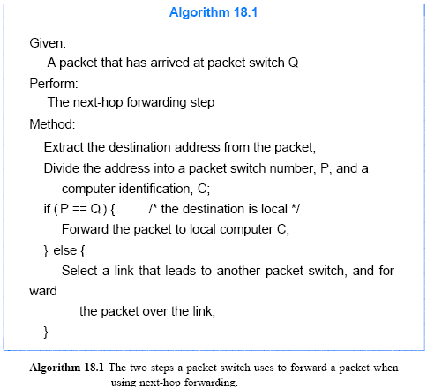

Slide 15
Choosing next hop
Packet switches
Keep the next hop info
Examine destination address in each packet and forwards to next hop if not local
Use a two-part hierarchical addressing scheme
The first part of the destination address to the final switch
The second part of the address is used to deliver the packet a specific computer

Slide 16
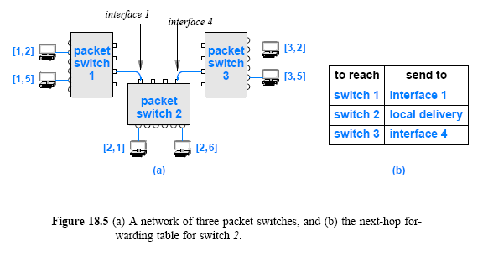

Slide 17
Source independence
Next hop to destination does not depend on source of packet
Allows fast, efficient routing
Packet switch keeps only next hop
Reduces the size of information to keep
Increases dynamic robustness - network can continue to function even if topology changes without notifying entire network

Slide 18
Dynamic Routing Updates in a WAN
Forwarding table must guarantee the following:
Universal communication
Must contain a valid next-hop route for each possible destination address
Optimal routes
The next-hop value must point to the shortest path to the destination
In case of Network failures
Forwarding should be changed to alternate available path
Static values may not be used for flexibility
Reconfigures the forwarding tables automatically

Slide 19
Dynamic Routing Updates in a WAN
Routing software is used to reconfigure forwarding tables
Route computation utilizes a graph that models the network
Compute the shortest path to all possible destinations
Each node in the graph corresponds to a packet switch in the network
An edge between two nodes represents a direct connection between a pair of packet switches

Slide 20
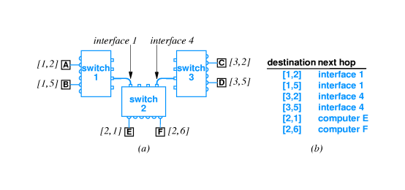
Hierarchical address and routing
Process of forwarding is called routing
Routing information is kept in routing table

Slide 21
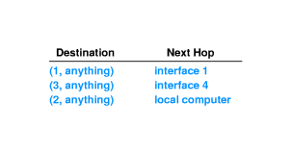
Hierarchical address and routing cont’
Note that many entries have same next hop
In particular, all destinations on same switch have same next hop
Routing table can be collapsed:

Slide 22
WAN architecture and capacity
As we add more computers, the volume of traffic increases
Can add capacity to WAN by adding more links and packet switches
Packet switches may or may not have attached computers
Interior switch – forwarding traffic between switches
Exterior switch – forwarding to and from computers

Slide 23
Routing in a WAN
Both interior and exterior switches:
Forward packets
Need routing tables
Must have:
Universal routing - next hop for each possible destination
Optimal routes - next hop in table must be on shortest path to destination

Slide 24
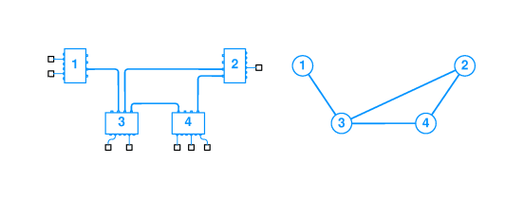
Modeling a WAN
Uses a graph
Nodes model switches
Edges model direct connections between switches
Captures essence of network, ignoring attached computers

Slide 25
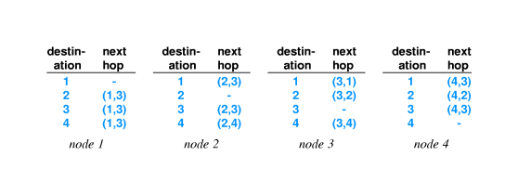
Route computation with a graph
Can represent routing table with edges:
Graph algorithms can be applied to find routes

Slide 26
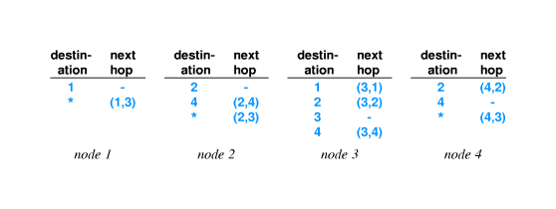
Default routes
Can collapse routing table entries with a default route
If destination does not have an explicit routing table entry, use the default route:

Slide 27
Building routing tables
How to enter information into routing tables:
Manual entry - initialization file
Dynamically - through runtime interface
How to compute routing table information:
Static routing - at boot time
Dynamic routing - allow automatic updates by a program
Static is simpler; doesn't accommodate changes to network topology
Dynamic requires additional protocol(s); can work around network failures

Slide 28
Computation of shortest path in a graph
Assume graph representation of network at each node
Use Dijkstra's algorithm to compute the shortest path from each node to every other node
Extract next-hop information from resulting path information
Insert next-hop information into routing tables

Slide 29
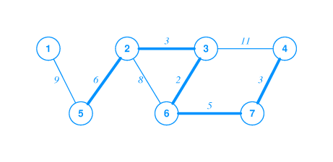
Weighted graph
Dijkstra's algorithm can accommodate weights on edges in graph
Shortest path is then the path with lowest total weight (sum of weights of all edges)
Shortest path not necessarily fewest edges (or hops)

Slide 30
Single Source Shortest Path
Dijkstra (G, w, s)
Initialize-single-source(g,s)
S ← ∅
Q ← v[g]
While Q ≠ ∅
Do u ← extract-min(q)
S ← S ∪ {u}
For each vertex v ∈ Adj[u]
Do relax (u, v, w)
** Keep track of the two sets –> S and Q

Slide 31
Dijkstra’s algorithm subroutines
Initialize_Single_Source (G, s)
for each vertex v ∈ V[G]
do d[v] <- ∞
Π[v] <- NIL
d[s] <- 0
Relax (u, v, w)
if d[v] > d[u] + w(u, v)
then d[v] <- d[u] + w(u, v)
Π[v] <- u

Slide 32
Dijkstra Example
a
b
2
2
s
8
1
9
2
4
c
3
d
 | S | a | b | c | d
D | 0 | 2 | 4 | 3 | 6
Π | N | S | a | a | c

Slide 33
Synopsis of Dijkstra's algorithm
Keep data structure with list of nodes and weights of paths to those nodes
Use infinity to represent a node in the set S of nodes for which a path has not yet been computed
At each iteration, find a node in S, compute the path to that node, and delete the node from Q

Slide 34
Distance metrics
Weights on graph edges reflect "cost" of traversing edge
Time (delay)
Cost
Hop count (weight == 1)
Resulting shortest path may not have fewest hops

Slide 35
Dynamic route computation
Network topology may change dynamically
Switches may be added
Connections may fail
Costs for connections may change
Switches must update routing tables based on topology changes

Slide 36
Distributed route computation
Pass information about network topology between nodes
Update information periodically
Each node recomputes shortest paths and next hops
Inject changes into routing tables

Slide 37
Distance-vector Routing (DVR)
Knowledge about the whole network:
each packet switch(router) sends out information about the entire network (whatever it has)
Routing only to neighbors
DVR messages are not broadcast
Sends out information only to the packet switches that have direct link
Information sharing at regular intervals
Sharing occurs whether or not the network has changed

Slide 38
Link-state Routing
Knowledge about the neighborhood
each packet switch sends out information about its neighborhood only
To all packet switches
Sends information to every other packet switch on the internet (flooding)
Information sharing when there is a change
Sends out information only when there is a change

Slide 39
Comparison
Distance-vector algorithm
Very simple to implement
May have convergence problems
Used in RIP (routing information protocol)
Link-state algorithm
Much more complex
Switches perform independent computations
Used in OSPF (open shortest path first)

Slide 40
Convergence problem in Distance Vector Algorithm
Although it converges to the correct answer, it may so slowly.
A B C D E
1
2
1 2 3
2 3 4 After 4 exchanges
A B C D E
1 2 3 4 initial state and A goes down
3 2 3 4 - no response from A
3 4 3 4
4 5 4 After 3 exchanges
5 6 5 6
6 7 6
……………………… The problem is known as count to infinity

Slide 41
Routing Problems
Most practical routing mechanisms contain constraints and heuristics to prevent problems like routing loops
Some solutions:
DVR schemes employ split horizon (preventing routing loop)
a switch does not send information back to its origin
most practical routing systems introduce hysteresis
prevents the software from making many changes in a short time
However, in a large network where many links fail and recover frequently, routing problems can occur

Slide 42
Examples of WAN technology
Historical
ARPANET
Began in 1960s
Funded by Advanced Research Projects Agency, an organization of the US Defense Department
Incubator for many of current ideas, algorithms and internet technologies
X.25
Early standard for connection-oriented networking
Developed by ITU-T (formally CCITT) in 1976
Requires DTE (data terminal equipment) and DCE (data circuit-terminating equipment)
Uses virtual circuit for packet switching and statistical TDM for multiplexing
Uses plain old telephone service connection or ISDN connections as physical links
Mostly replaced by IP
Frame Relay
Long-distance carrier service for delivering blocks of data
Connection-based service originally designed for ISDN
Typically 56Kbps or 1.5Mbps; can run to 100Mbps; mostly used in areas where DSL or cable modem services are lacking

Slide 43
Examples of WAN technology con’t
SMDS - Switched Multi-megabit Data Service
Also a Long-distance carrier service
Connectionless service; any SMDS station can send a frame to any other station on the same SMDS "cloud"
Typically 1.5-100Mbps, cell technology (like ATM)
ATM - Asynchronous Transfer Mode
Designed as single technology for voice, video, data, ...
Low jitter (variance in delivery time) and high capacity
Uses fixed size, called cells - 48 octets data, 5 octets header
Can connect multiple ATM switches into a network
Gigabit Ethernet with Layer 7 switch
Uses fiber optics
Application monitoring and data collection
HTTP URI applications

Slide 44
Examples of WAN technology con’t
Multi-Protocol Label Switching (MPLS) and Tunneling
An extra feature of conventional routers
Take incoming packets and place each packet in a special wrapper that contain a label.
Each labeled packet follows a label switched path
To use this technology, each router must be equipped with MPLS capability.
MPLS can be used selectively, e.g., between two branches of a big company
Tunneling is defined as the transmission of traffic that uses on a high-level protocol over another high-level protocol

Slide 45
Summary
WAN can span arbitrary distances and interconnect arbitrarily many computers
Uses packet switches and point-to-point connections
Packets switches use store-and-forward and routing tables to deliver packets to destination
WANs use hierarchical addressing (two part address)
Graph algorithms can be used to compute routing tables
Two basic routing algorithm
Distance vector
Link state

